Slide 1
ISE 291 – Introduction to Data Science Term 222 Project -
Team 9 – Section 3
Abdulaziz Alangari 201962330
Omar Alarjani 201943670
Omar Alawaji 202025780
Ali Albu ali 202039440

Slide 2
First Stage: Discovery

Slide 3
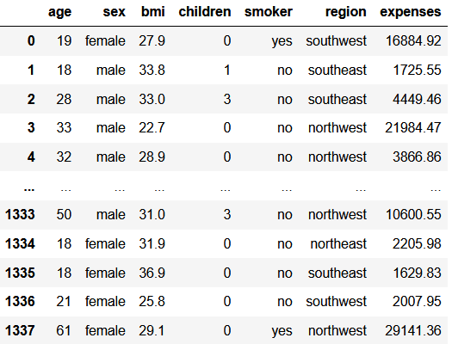
Insurance Premium Prediction
The selected data lists the insurance expenses of a 1338 participants with additional factors that are suspected to affect the expenses.
https://www.kaggle.com/datasets/noordeen/insurance-premium-prediction
Source:

Slide 4
Second Stage:
Data Preparation

Slide 5
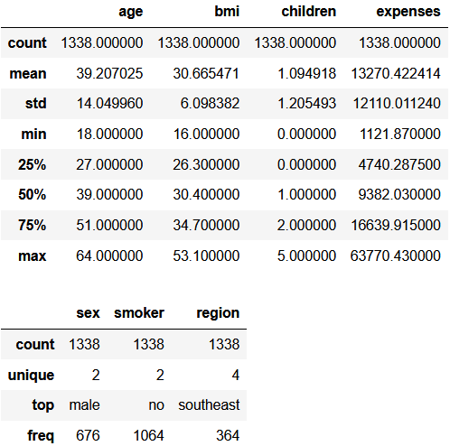
Statistical summaries
The data shows no inconsistencies nor null values since it has been solved, therefore, the data is ready to proceed to the next stage.

Slide 6
Third Stage:
Model Planning

Slide 7
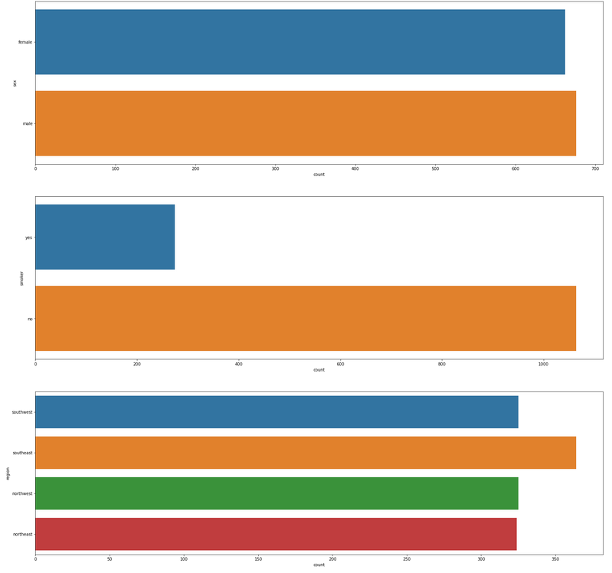
Graph A which shows the distribution of participants based on the non numerical factors. (Sex , Smoking and Region) respectively.

Slide 8
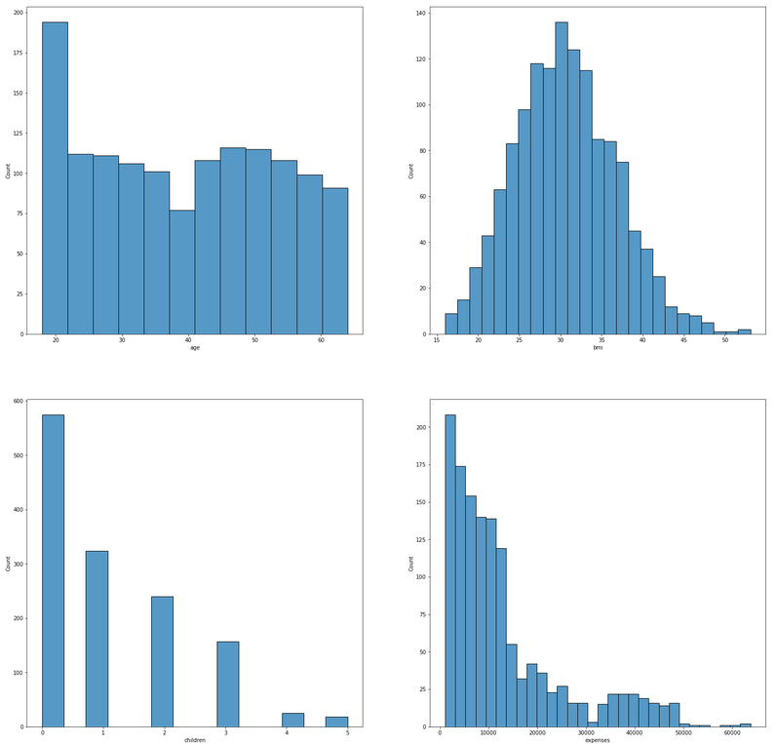
Graph B which shows the distribution of participants based on the numerical factors in bins. (Age , BMI, Number of children and expenses) respectively.

Slide 9
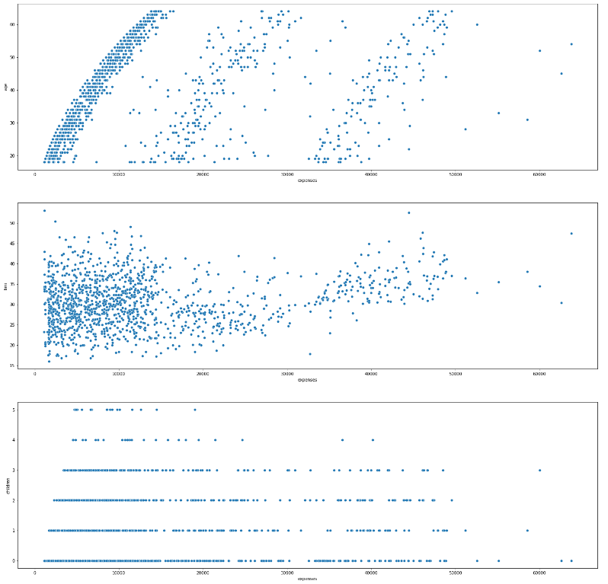
Graph C which shows a scatterplot of the relationship between numerical elements vs expenses
(Age , BMI and Number of children) respectively.

Slide 10
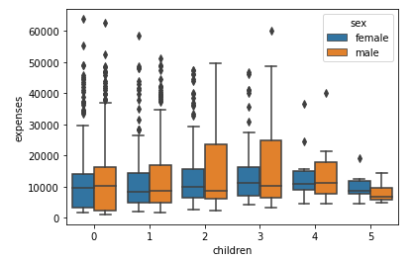
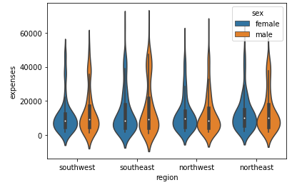
Graphs D and E which shows a multi-variable possible relationships
(Left : Children vs expenses differentiated by sex,
Right: Region vs expenses differentiated by sex)

Slide 11

Noticed Results

Slide 12
Fourth Stage:
Model Building

Slide 13

Why Regression?

Slide 14
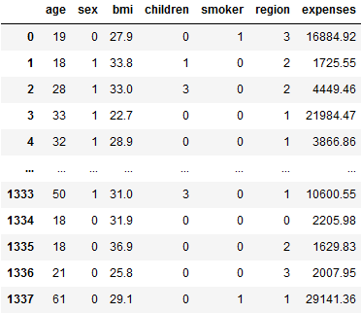
Data after optimization for linear regression using label encoding

Slide 15
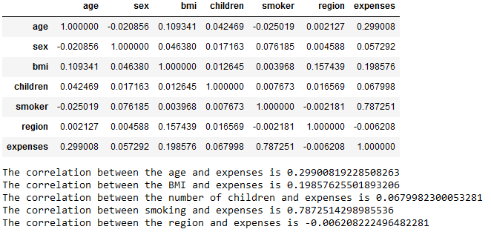
A data frame showing the correlations between input factors and expenses

Slide 16
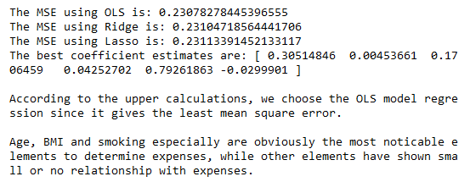
MSE (Mean Square Error) of the three used regression models

Slide 17
Fifth Stage:
Operationalize

Slide 18
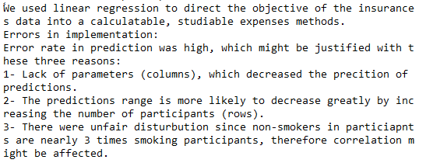
General methodology discussion

Slide 19
Sixth Stage:
Communicate results

Slide 20
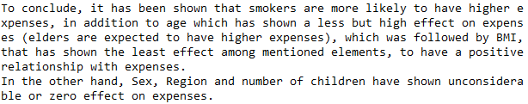
Results and conclusion

Slide 21
Thank you for listening
Team 9

